Slide 1
“Data structures”
Course report
Author: Norkin Mark

Slide 2
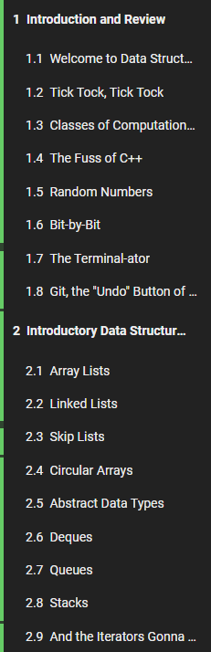
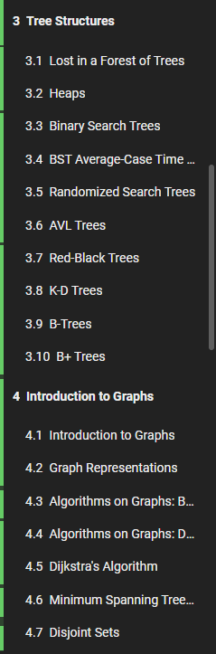
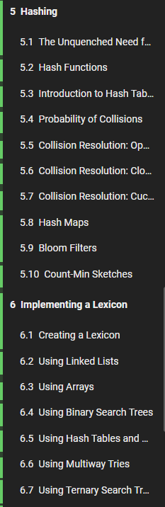
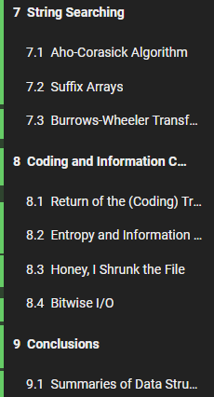
About the course
Course program:
Introduction and Review
Introductory Data Structures
Tree Structures
Introduction to Graphs
Hashing
Implementing a Lexicon
String Searching
Coding and Information Compression
Conclusions

Slide 3
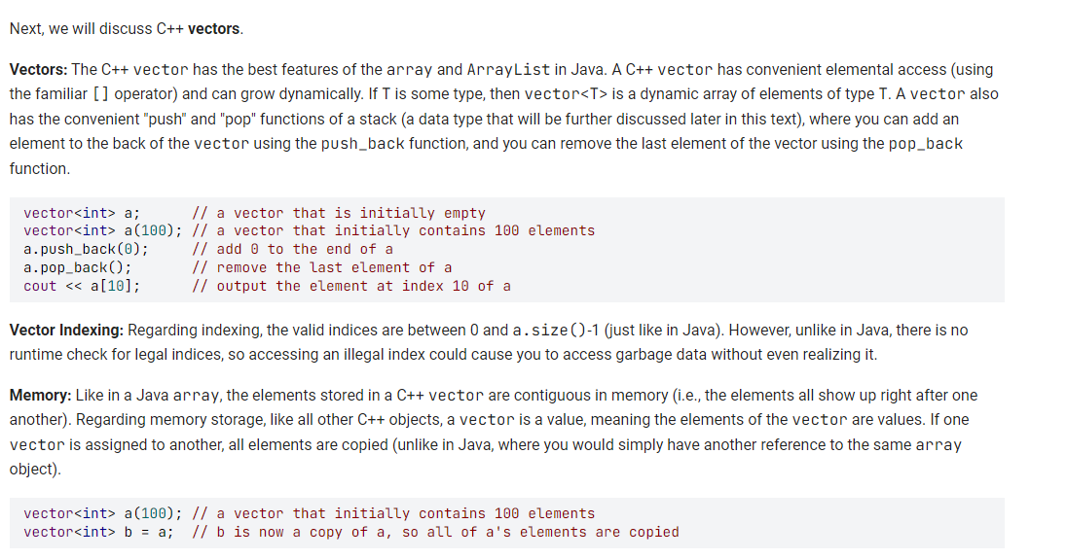
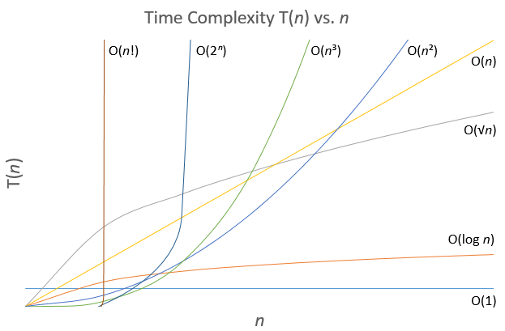
Introduction

Slide 4
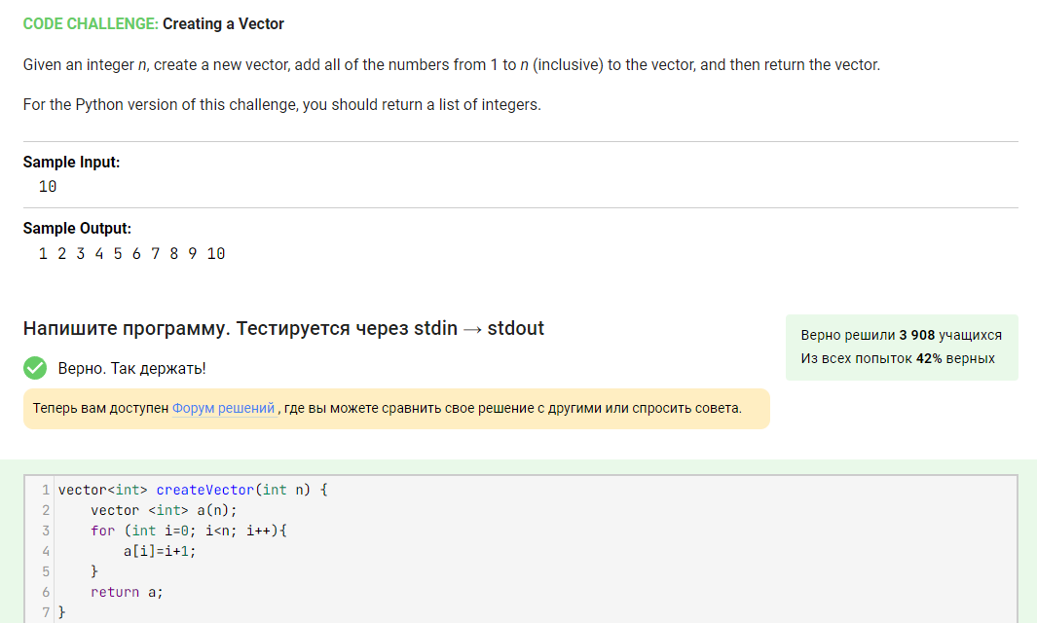
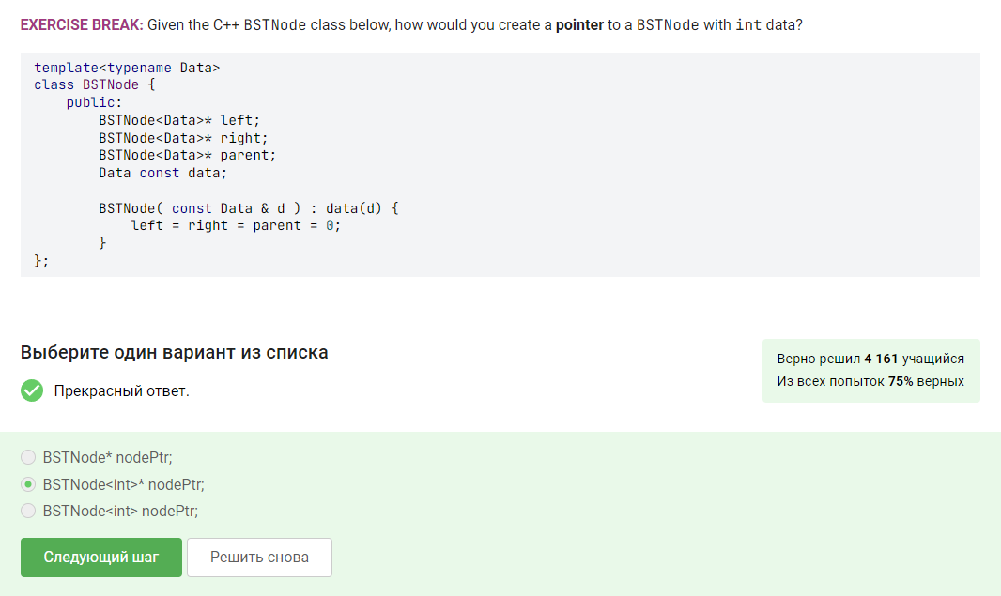
Introduction

Slide 5
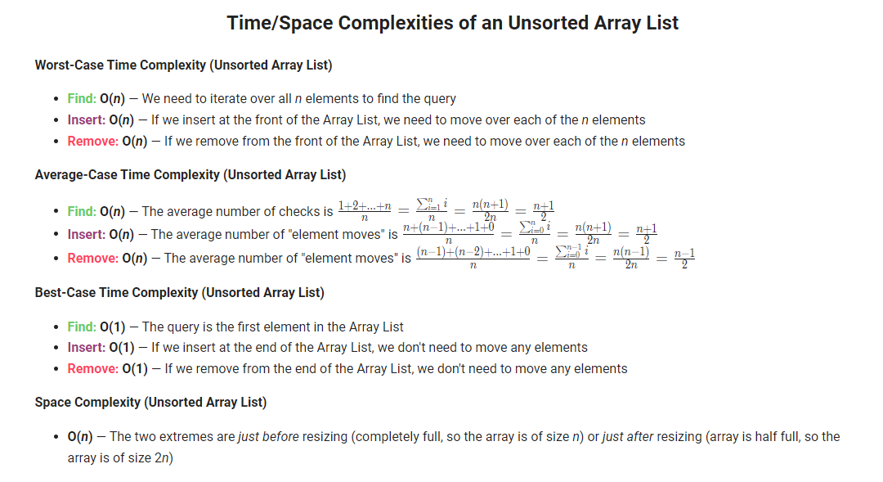
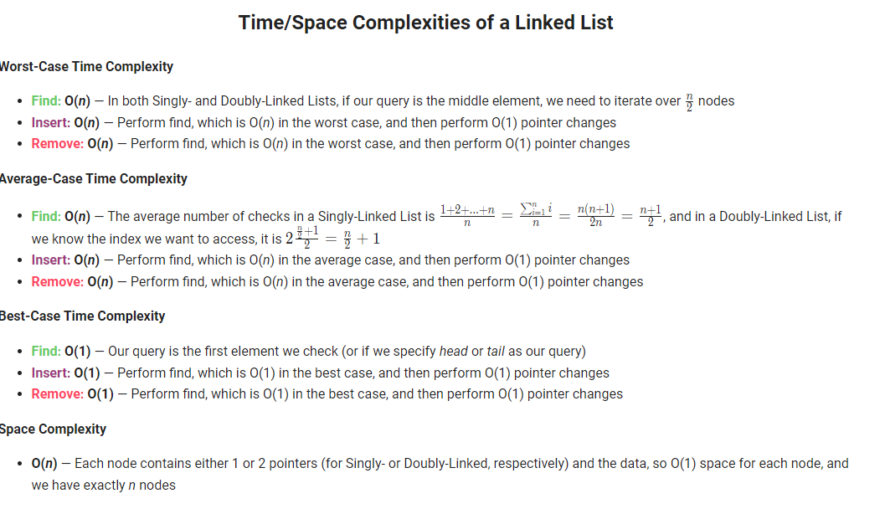
Basic data structures
Arrays, linked lists, skip lists, circular arrays, deques, queues, stacks

Slide 6
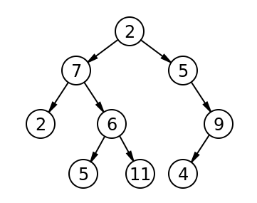
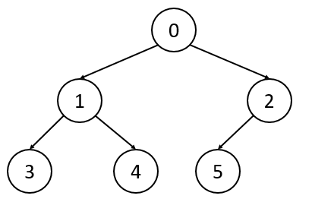
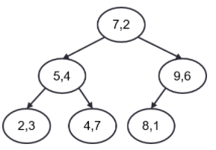
Tree structures
Trees, heaps, binary search trees, AVL-trees, red-black trees, B-trees, B+ trees
Simple tree
Heap (higher priority is given to smaller elements)
K-D tree

Slide 7
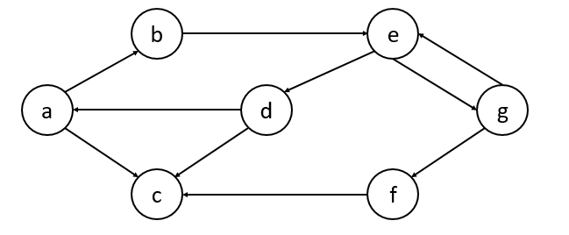
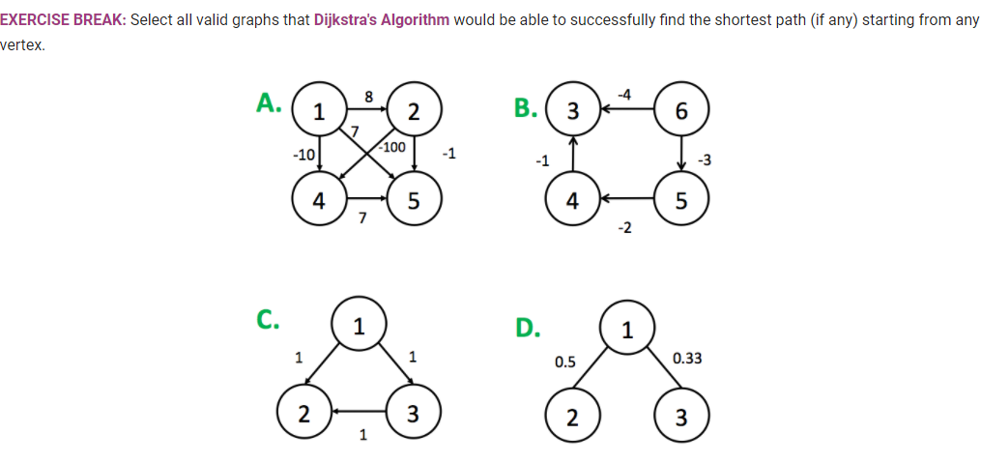
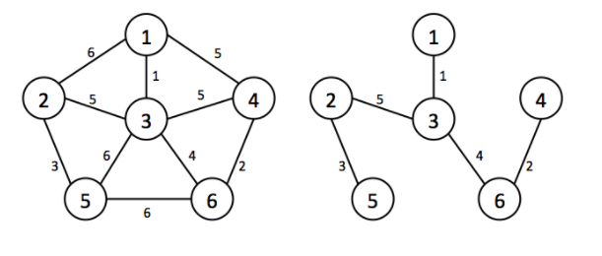
Graphs
Types of graphs, breadth search, depth search, Dijkstra’s algorithm, minimum spanning trees

Slide 8
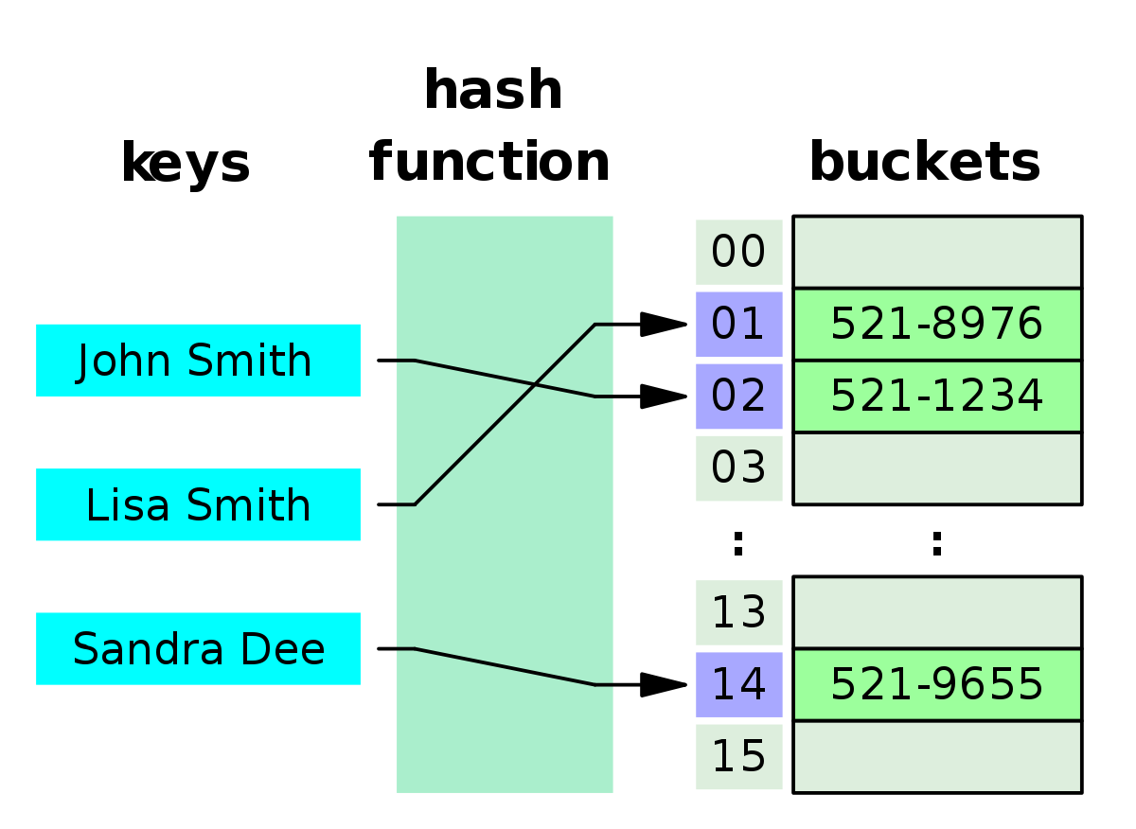
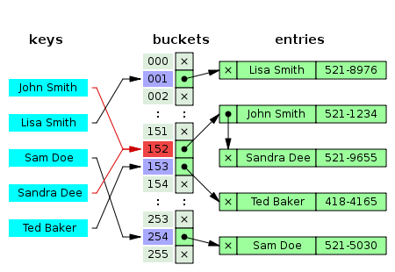
Hashing
Hash tables, hash functions, problems of collision

Slide 9

Results
Thank you for your attention!

